Slide 1
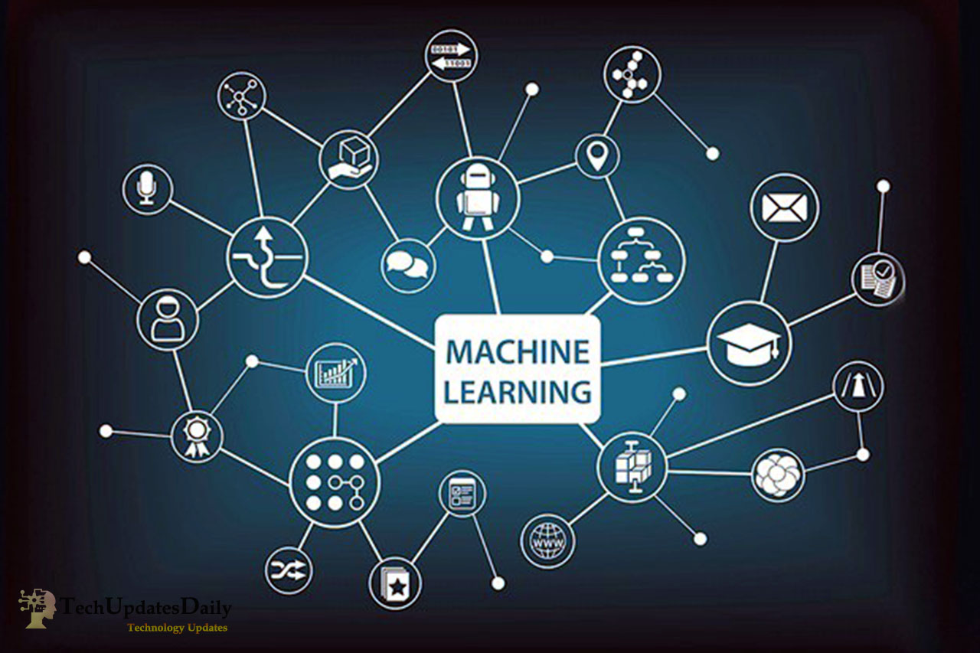
Sales Forecasting for Furniture Store
Machine Learning
Name: Samarth Pansala
Date: 22nd August, 2024

Slide 2
Table of contents
01
02
03
04
05
06
Problem Statement
Dataset Overview
Data Preprocessing
Model Development
Results and Evaluation
Insights and Business Impact

Slide 3


ML
Problem Statement
The Challenge

Slide 4
Problem Statement
Introduction to the Problem:
The furniture store struggles to predict future sales accurately.
Challenges include inventory mismanagement, ineffective marketing, and financial uncertainties.
Objective:
Develop a machine learning model to forecast future sales trends.
Enable the store to optimize inventory, enhance marketing efforts, and improve financial planning.
Key Question: How can we predict future sales trends accurately?

Slide 5
Dataset Overview
Understanding the Data Dataset Features:
Row ID: A unique identifier for each record in the dataset.
Order ID: Identifies each order placed by customers.
Order Date & Ship Date: Tracks when orders were placed and shipped.
Ship Mode: The method used for shipping, such as Standard or First Class.
Customer Details: Includes Customer ID, Name, Segment (Consumer, Corporate, Home Office).
Geographical Data: Country, City, State, Postal Code, Region.
Product Information: Product ID, Category, Sub-Category, and Product Name.
Sales, Quantity, Discount, Profit: Key financial metrics for each order.
Purpose: These features help build a predictive model for future sales.

Slide 6
Data Preprocessing (Preparing the Data)
1) Handling Missing Values
2) Feature Engineering
3) Encoding Categorical Variables
4) Data Transformation

Slide 7
Model Development (Building the Model)
1) Choosing the Model
2) Data Splitting
3) Model Training
4) Evaluation Metrics
5) Visual Example

Slide 8
Results and Evaluation (Assessing the Model)
25%
50%
75%
Model Performance
Visual Representation
Insights from the Results

Slide 9

Conclusion and Future Work
Success: Developed a model that provides actionable sales forecasts.
Future Improvements: Consider more advanced models, incorporate external data, and deploy the model in production.
Business Impact: Improved decision-making in inventory and marketing.

Slide 10

Thank You

